Slide 1
Eat with Chef
Group Members
Nguyễn Thành Nhân
Lê Quang Khương Duy
Trương Quang Bảo
Phạm Văn Duy
Supervisor
Lâm Hữu Khánh Phương
Group 6

Slide 2
Contents
Business Overview & Solutions
Food Traceability
Main Functions
Technology
Summary
Demo

Slide 3



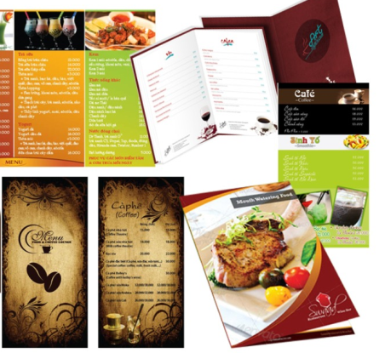

Problem
c
Lack of time to cook
Not confirm food safety
c
c
Bad cooking skill
Want flexible menu
Want delicious dish from chef

Slide 4



Current trend in Viet Nam

Slide 5
Solution
EWC E-commerce
Food safety & traceability

Slide 6




Solution: EWC E-commerce
Lack of time
Professional food
Who cook your foods?
Daily flexible menu
Food traceability

Slide 7




Solution: EWC E-commerce
Problems
Solutions
Eat good foods
Daily flexible menu
Increase sale & customer relationship
Design and prepare foods
Share cooking experiences
EWC Company
Customer
Eat with chef
System
Chef

Slide 8
Solution: Food Safety & Traceability
EWC Food Safety
Food Origin
How to prepare to cook safety
When is the food cooked

Slide 9
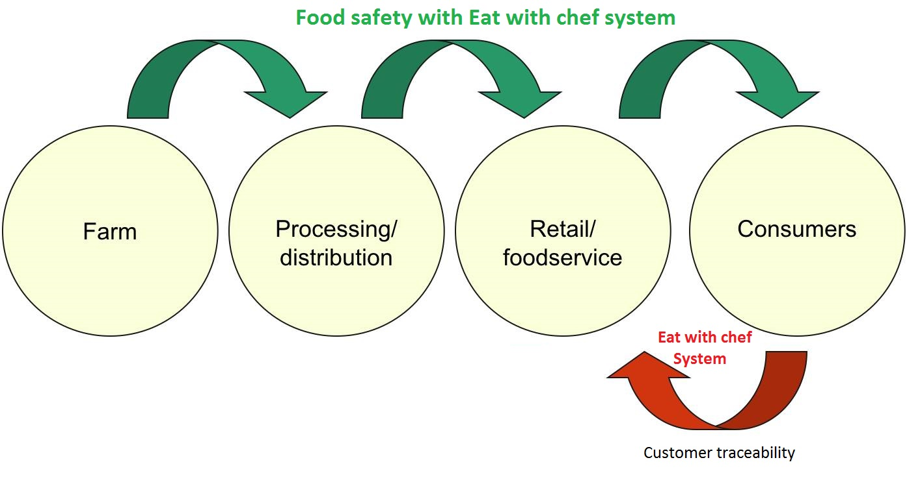
Solution: Food Safety & Traceability
An effective traceability system relies on being able to track product one step forward and one step back at any point in the supply chain.
1
2
3
4

Slide 10
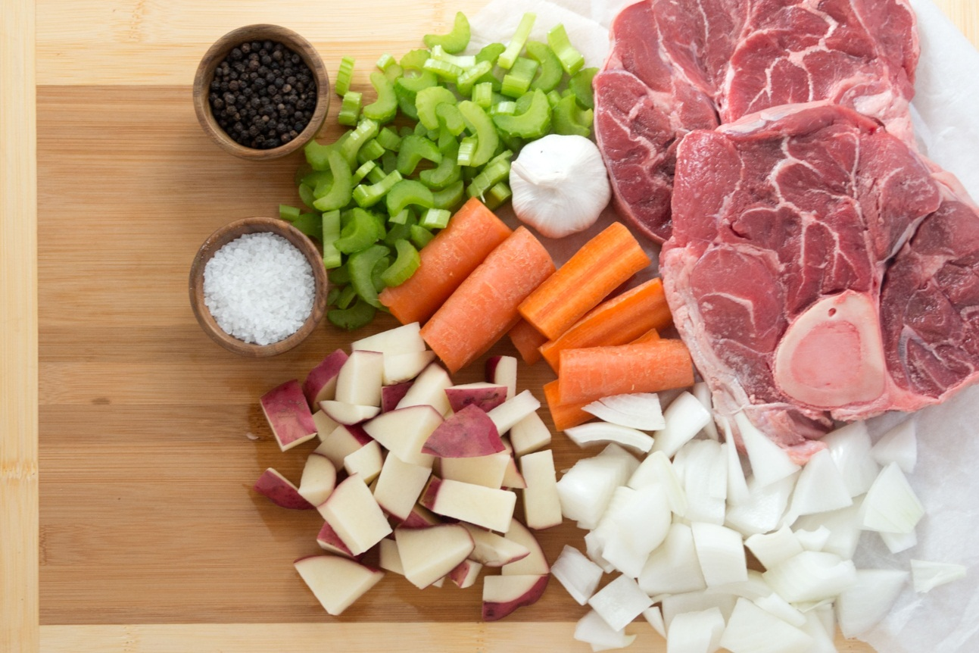
Solution: Food Safety & Traceability
Traceability should be able to identify the source of all food input:
raw materials
additives
other ingredients
packaging
Main Ingredients

Slide 11

Solution: Food Safety & Traceability
The system has in place includes any procedures for identifying producers, suppliers, customers and products and the records:
name and address (and other contact details) of suppliers/customers
date of transaction or delivery
volume or quantity of product
any other relevant production records

Slide 12
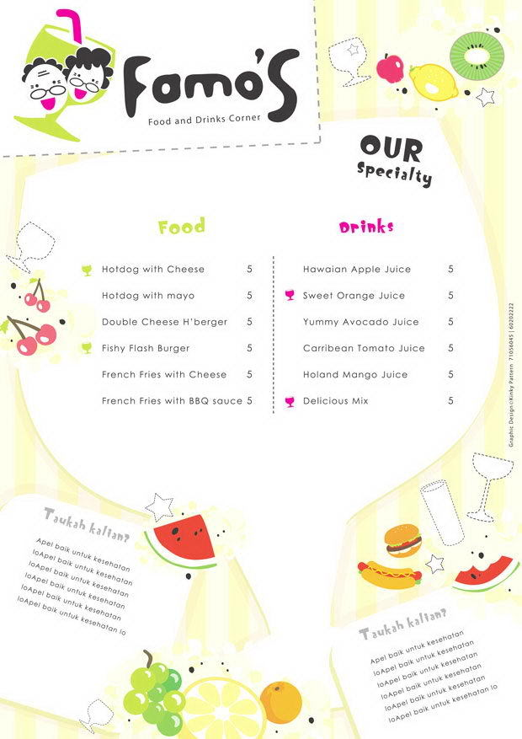

Food Traceability Process - Step 1
Staff
Publish daily menu

Slide 13

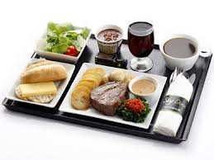
Food Traceability Process - Step 2
Order dishes
Customer

Slide 14

Food Traceability Process - Step 3
Chef
Cook food

Slide 15


Food Traceability Process - Step 4
Scan QR Code
Customer
Food Origin

Slide 16
Main function & Summary

Slide 17
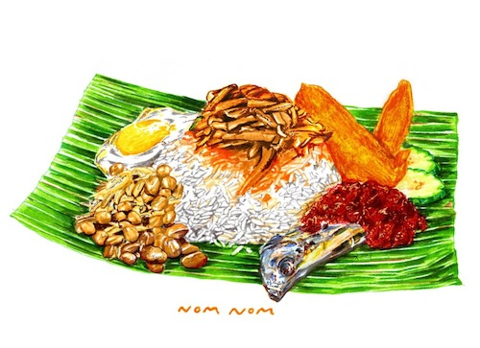
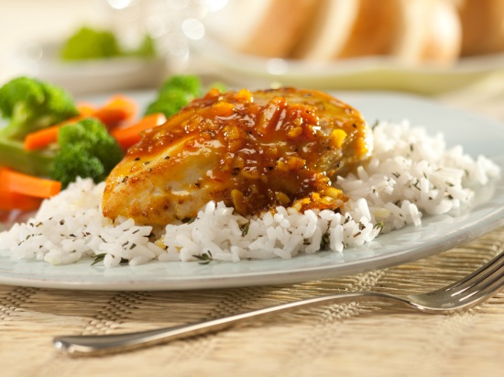

Terms
Dish and Dish Item
05/05/2014 13:30
Đầu bếp: Cẩm Vân
Nguyên liệu Nhà cung cấp
Gà Vissan
Cà rốt Nông trại Long Thành
Bông cải VCM Đà Lạt
Gạo thơm Long An Food
Cook
Dish
Dish Item
Dish: store information describe dish and available for customer to order.
Dish Item: is a dish include more information about cooking and specific ingredients used. Then dish item will be delivered to customer.

Slide 18


Terms
Ingredient and Ingredient Item
Nhà cung cấp
Nông trại Long Thành
VCM Đà Lạt
Ingredient
Ingredient Item
Ingredient: store information describe Ingredient and available for chef design dish.
Ingredient Item: is a Ingredient include more information about supplier. Then ingredient use to cook dish item.

Slide 19
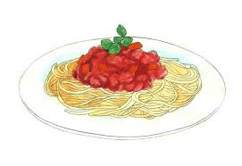


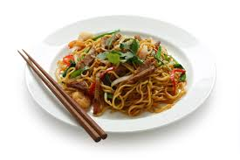
Terms
Dish produce session
Show produce session by order
Order dish
Produce Session
View
Dish need cook today
Cook

Slide 20
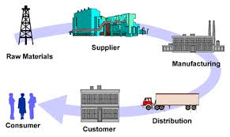
Main functions
Publish daily menu
Manage supplier & Ingredient
Staff

Slide 21

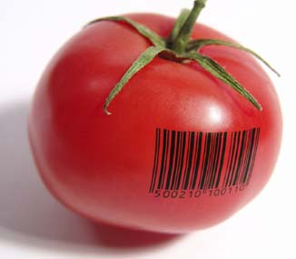
Main functions
Order dishes
Online payment
Customer
View ingredient traceability

Slide 22
Main functions
Create dish produce session
Chef

Slide 23





Technology
Microsoft Team foundation server

Slide 24
Summary
Achievement
Customer can order dishes easily
Customer can view ingredient traceability by scan QR code and web
Customer can ask cooking question with chef
Staff can publish and manage flexible daily menu
Staff can manage orders easily
Chef can create produce session
Chef can answer cooking question
Limitation
Support only one payment method with Pay Pal
Does not support delivery system

Slide 25
Summary
Future plan
Develop delivery system.
Integrate more online payment methods
Implement gaming and more social for customer
Improve system performance
Improve system as user friendly as possible
Improve business concept

Slide 26
Q&A
Thanks for your listening

